Slide 1
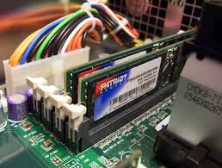
RAM(RANDOM ACCESS MEMORY)

Slide 2
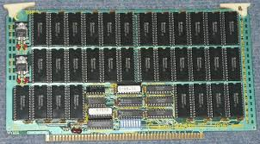
TYPES OF RAM
Static RAM: SRAM is random access memory that retains data bits in its memory as long as power is being supplied.

Slide 3
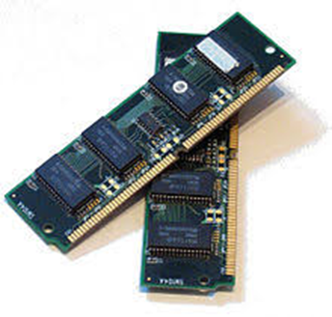
Dynamic RAM: Dynamic random-access memory is a type of random access semiconductor memory that stores each bit of data in a separate tiny capacitor within an integrated circuit.

Slide 4
TYPES OF DYANMIC RAM
SDRAM
DDR SDRAM
DDR2 SDRAM
DDR3 SDRAM
DDR4 SDRAM

Slide 5
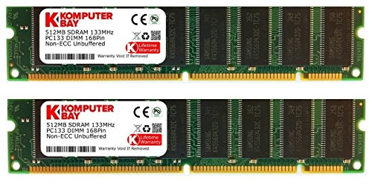
SDRAM
It stands for Synchronous Dynamic Random Access Memory.
SDRAM is designed to synchronize itself with the timing of the CPU.

Slide 6
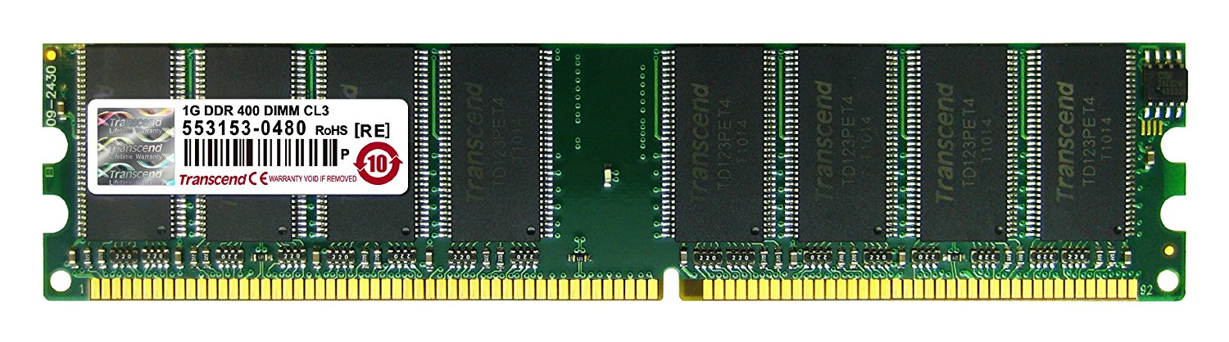
DDR SDRAM
The next generation of SDRAM is DDR, which achieves greater bandwidth than the preceding single data rate SDRAM by transferring data on the rising and falling edges of the clock signal.

Slide 7
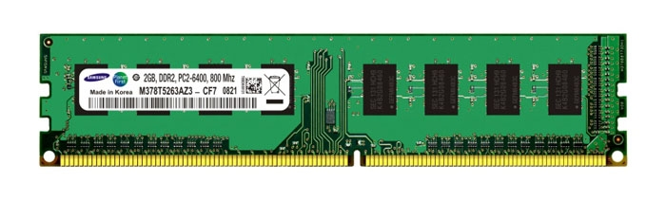
DDR2 SDRAM
Its primary benefit is the ability to operate the external data bus twice as fast as DDR SDRAM. This is achieved by improved bus signal.

Slide 8
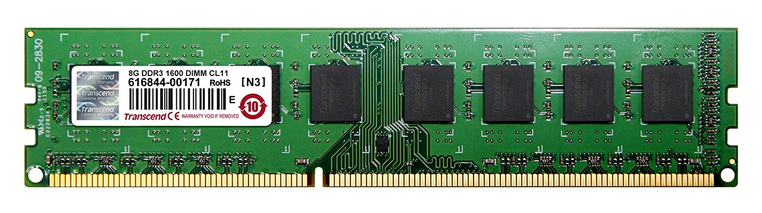
DDR3 SDRAM
DDR3 memory reduces 40% power consumption compared to current DDR2 modules, allowing for lower operating currents and voltages.

Slide 9
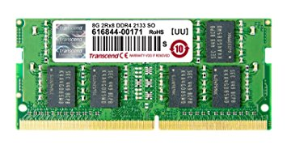
DDR4 SDRAM
DDR4 SDRAM provides the lower operating voltage (1.2V) and higher transfer rate.

Slide 10
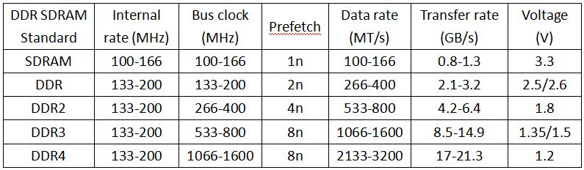
DIFFERENCE BETWEEN SDRAM, DDR, DDR2, DDR3, DDR4

Slide 11
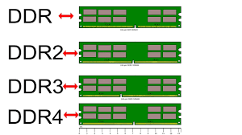
DIFFERENCE BETWEEN DDR, DDR2, DDR3, DDR4

Slide 12
TYPES OF RAM SLOTS
SIMM slot :
SIMM RAM had to be installed at an angle and pushed upright into place.
DIMM slot :
DIMM slots allow for straight-forward installation of memory modules.
RIMM slot :
The module slots for RIMMs were physically similar to DIMM slots and the modules were installed in the same way.

Slide 13
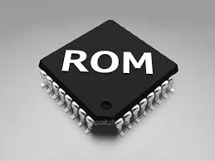
ROM(READ ONLY MEMORY)

Slide 14
TYPES OF ROM
Masked ROM
PROM
EPROM
EEPROM
Flash ROM

Slide 15
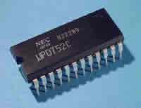
Masked ROM
It is also known as MROM. It is a static ROM which comes programmed into an integrated circuit by its manufacturer.

Slide 16
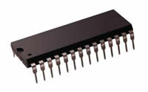
PROM
It stands for Programmable Read Only Memory.
The data stored in it cannot be modified and therefore it is also known as one time programmable device.

Slide 17
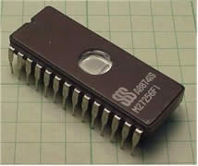
EPROM
It stands for Erasable Programmable ROM. It is different from PROM as unlike PROM the program can be written on it more than once.

Slide 18
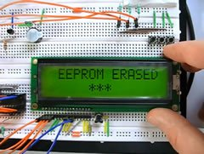
EEPROM
It stands for Electrically Erasable Read Only Memory.
These are also erasable like EPROM, but the same work of erasing is performed with electric current.

Slide 19
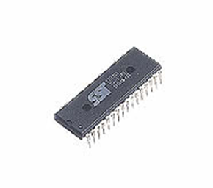
Flash ROM
It is an updated version of EEPROM.
Flash memory provides this advantage over the EEPROM by enabling this feature of altering many locations simultaneously.

